Slide 1
Synchronization of coupled oscillators

Slide 2
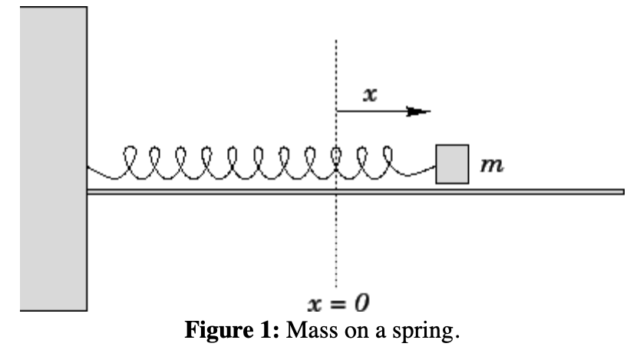
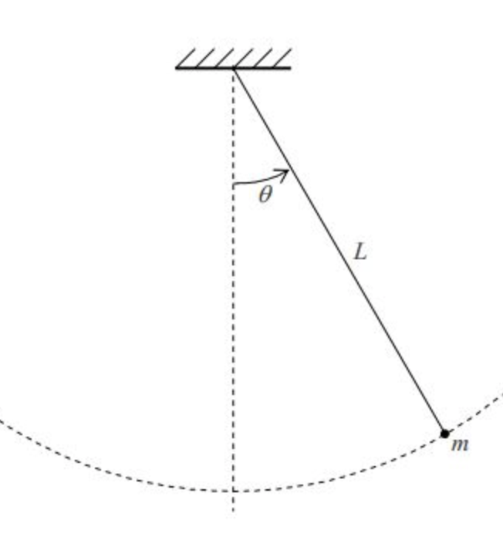
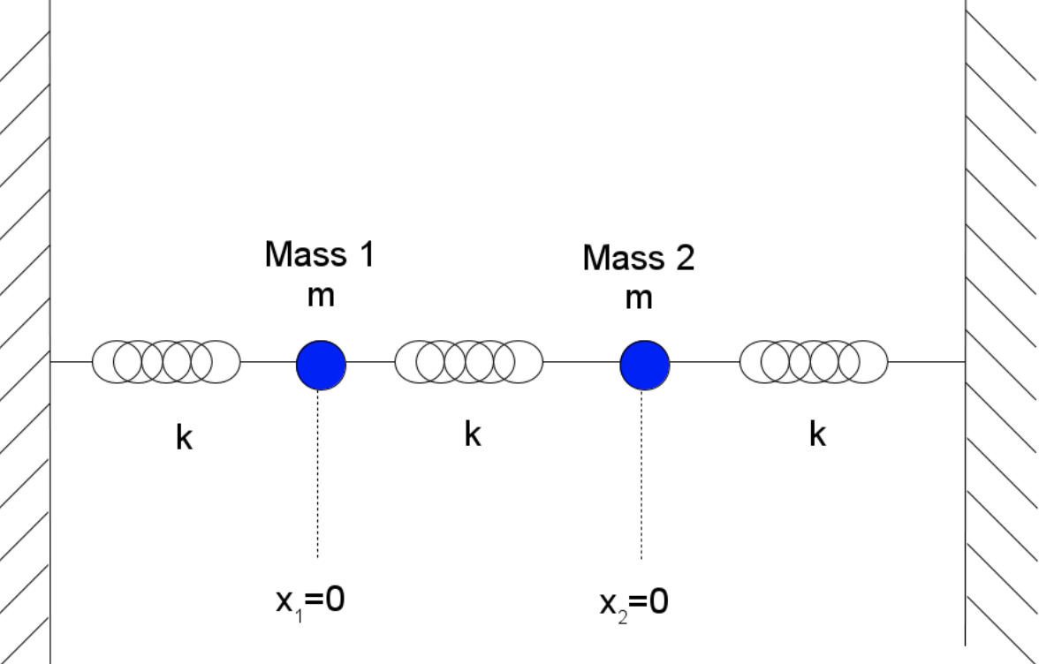

Oscillators
The repetitive motion of a system over time
Simplest versions being pendulums or a mass on a spring
The second order differential equations that represents a harmonic oscillator is seen in many areas of physics and mathematics. Written as a system of first order differential equations: --(insert Eq’s)
With the solution being a linear combination of sine and cosine waves: (insert EQ)
Coupled Oscillators refers to when multiple oscillating systems are connected in a way that they can exchange energy.

Slide 3
Oscillators
The repetitive motion of a system over time
Simplest versions being pendulums or a mass on a spring
The very common second order differential equations that represents a harmonic oscillator is seen in many areas of physics and mathematics. Written as a system of first order differential equations:
With the solution being a linear combination of sine and cosine waves:
Coupled Oscillators refers to when multiple oscillating systems are connected in a way that he can exchange energy.
Notes:
Maybe do more examples of oscillators, or make “Coupled Oscillators it’s own slide

Slide 4
Spontaneous Synchronization
Pacemaker Cells
Fireflies
Millenium Bridge in London---relate to metronoms in next slide
Notes:
Give details about these examples, and maybe attach pictures!

Slide 5


Dynamical Systems Perspective
What we learned in this class
2end order system written as a first order system (1)
Lienard Systems (20)
Van Der Pol Oscillator (20)
Notes:
Ch 1 A harmonic Oscillator is a autonomous system, a forced harmonic oscillator is a non autonomous system. Linear vs nonlinear
Ch 12: 2D continuous systems, found fixed points, drew nullclines, energy conserving system, classified as a center
Ch 20:

Slide 6
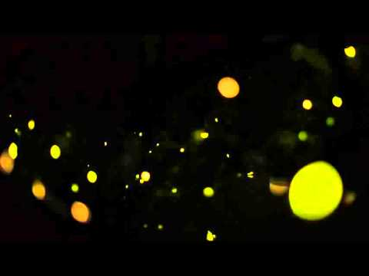
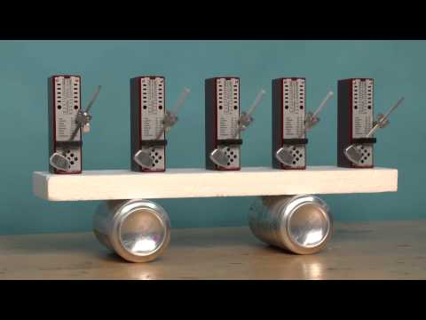
Spontaneous Synchronization
Notes:
Talking points: In the first video fireflies synchronize with led lights.
In the second metronomes synchronize with each other
Use both examples to discuss how these systems individual parts can be considered oscillators, and collectively are “coupled”oscillators. Also foreshadow “influence” and “sensitivity” functions in the way that the system is coupled. Fireflies influence each other, and the metronomes are attached to the table and you can physically see how it responds to their synchronization

Slide 7
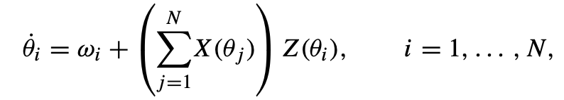




Historical Overview:
The Formulation of the Mathematical Foundations of Spontaneous Synchronization
Wiener (1958) : Wrote a book “Nonlinear Problems in Random Theory” where he talked about alpha waves in the brain
Winfree (1967): Grad Project
Assumed a large population of interacting oscillators
As an oscillator he knew that there existed a limit cycle (maybe go in depth and what we have learned in class)
Assumed the coupling was weak and the oscillators nearly identical
Defined the coupling factor as a mean-field approximation
Where is the phase of oscillator i
is it’s natural frequency
Given N oscillators the oscillator i is influenced by two forces.
The phase dependent influence of its neighbors
And the response of oscillator i depending on its own phase
Notes:
Talking Points:
Discuss Wieners postulation that there are oscillating cells in the brain with a gaussian distribution of natural frequencies that interact and create the power spectrum of alpha waves--he sees it as an example of spontaneous synchronization
Winfree: interested in biological rhythms. Assumed a large population of interacting limit-cycle oscillators (define this). Made it one dimensional (point going around a loop) valid if coupling is weak. They must interact! (relate to fireflies and metronomes) via “influence”and “sensitivity” functions. Talk about relevance of a mean-field approximation. Talk about time scales and the numerical simulations where this model predicted a phase transition and the “freezing” of synchronized clusters, given certain conditions/parameters

Slide 8

Kuramoto Model

